Slide 1
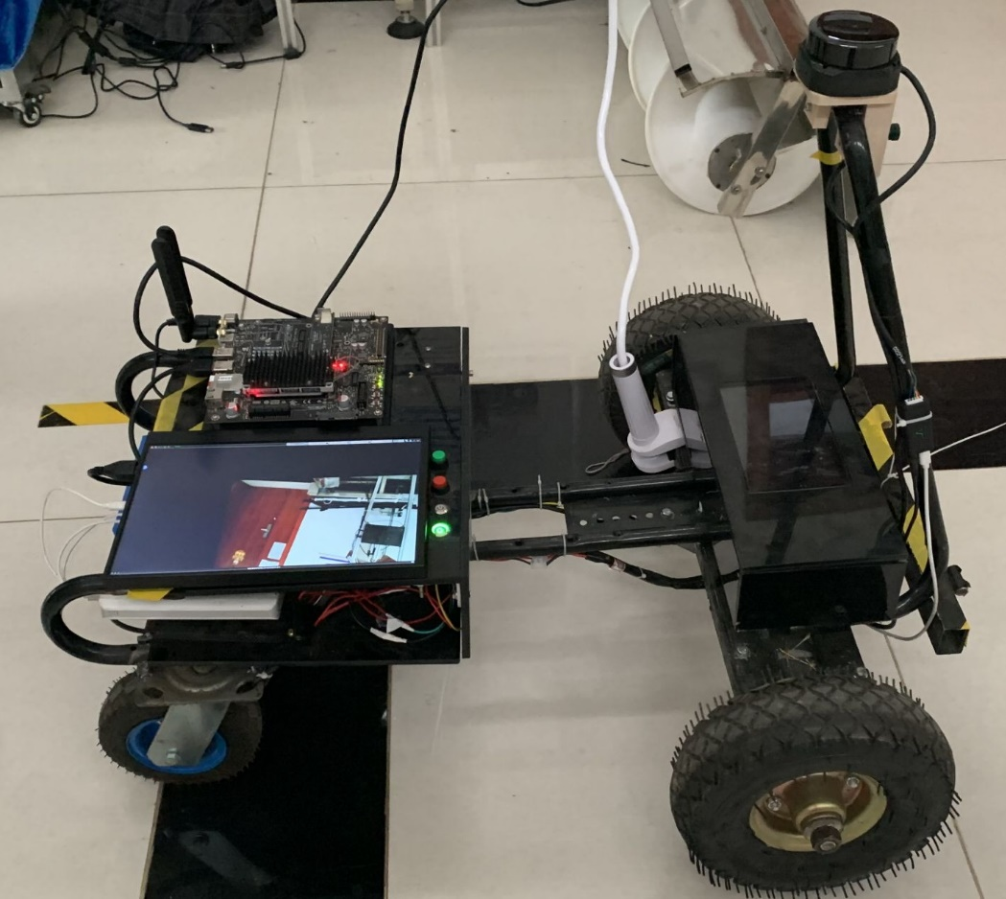
Relay is used to control the grass-flipping and cleaning device.
By mounting a LiDAR sensor, the robot collects data to build an orchard map.
Arduino controls the robot’s speed through PWM.
Communication is achieved through the USB serial port.
Raspberry Pi is used to program the robot model, create basic function nodes, and implement orchard mapping, navigation, and obstacle-avoidance algorithms.
The robot determines its position based on map features around it.
Notes:
1

